Slide 1
PDS
SDN
NFV
Computer Vision
Konfigurasi Ubuntu Server_DNS
Lab1
https://github.com/siagianp
https://www.youtube.com/@AmelOline/videos
https://github.com/amelcharolinesgn2/IoT_simulator-mqtt-NodeRed
https://github.com/amelcharolinesgn2/Cloud-Infrastructures
https://github.com/amelcharolinesgn2/ClouD-Infrastructure-SISKA-2025
Notes:
http://www.sophphx.caltech.edu/Physics_5/Experiment_6.pdf

Slide 2
Instalasi : Server Ubuntu and Domain Name System

Slide 3
Instalasi Server Ubuntu Syarat Minimum Hardware Server
Dalam Instalasi Server ubuntu dibutuhkan beberapa syarat minimum Hardware, sebagai berikut
Processor : Intel Pentium 5
Memory : 256 MB
Free Harddisk : 5 GB

Slide 4
Alur Instalasi Ubuntu Server
Masukkan CD Installer
bahasa install
Keyboard Layout
Network Card
Username Password
Partisi
Time Zone
Hostname
DHCP
Aplikasi
Boot Loader
Pilih cancel jika ingin setting IP
setelah instalasi
FINISH

Slide 5
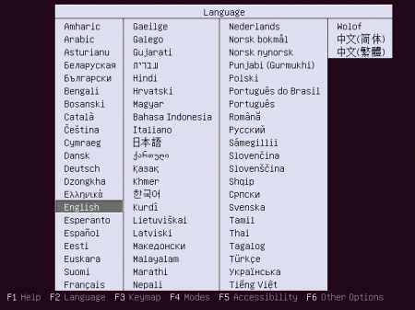
Proses Instalasi 1. Pilih Bahasa Instalasi

Slide 6
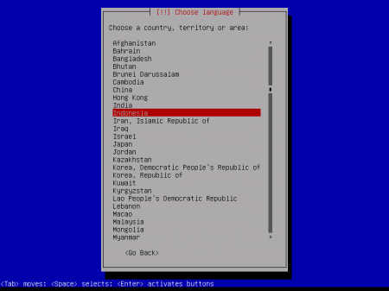
Proses Instalasi 2. Pilih Bahasa Sistem Ubuntu

Slide 7
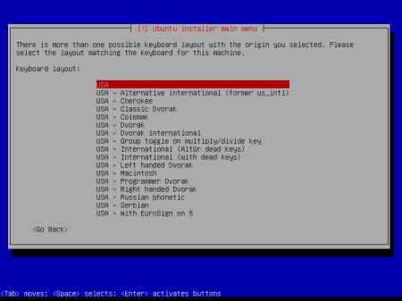
Proses Instalasi 3. Pilih Layout Keyboard

Slide 8
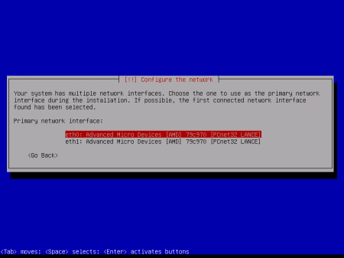
Proses Instalasi 4. Konfigurasi Primary Kartu Jaringan

Slide 9
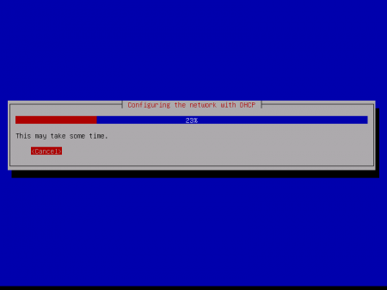
Proses Instalasi 5. Setting DHCP ( jika belum terkoneksi dengan jaringan, maka tekan tombol cancel)

Slide 10
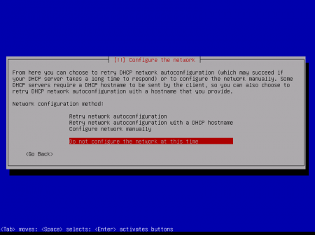
Proses Instalasi 6. Setting DHCP - lanjutan ( jika ingin seting network setelah selesai instalasi, pilih Do not configure the network at this time)

Slide 11
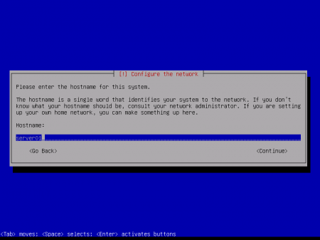
Proses Instalasi 7. Setting Hostname Server

Slide 12
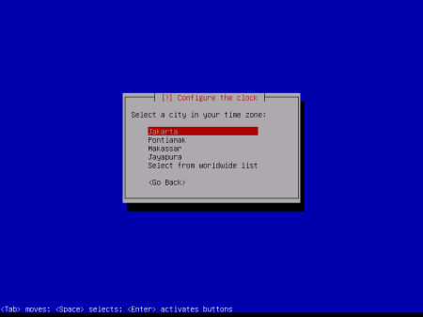
Proses Instalasi 8. Pilih Zona Waktu

Slide 13
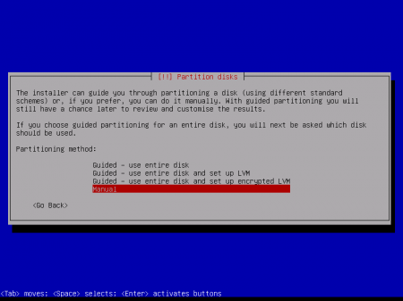
Proses Instalasi 9. Setting Partisi Hardisk

Slide 14
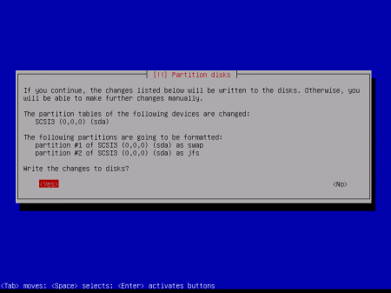
Proses Instalasi 10. Setting Partisi Hardisk- lanjutan

Slide 15
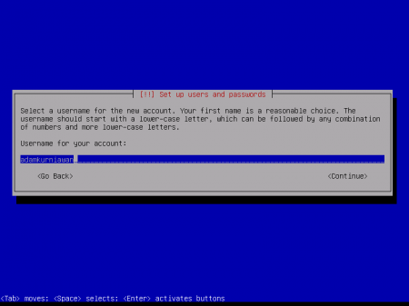
Proses Instalasi 11. Setting Username dan Password

Slide 16
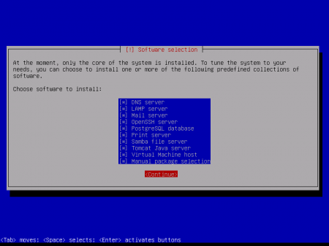
Proses Instalasi 12. Pilih Aplikasi Server

Slide 17
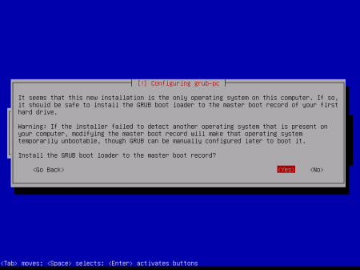
Proses Instalasi 13. Instalasi Boot Loader

Slide 18
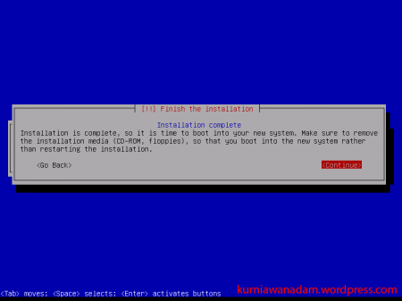
Proses Instalasi 14. Instalasi Selesai

Slide 19

Proses Instalasi 15. Tampilan Halaman Login

Slide 20
Instalasi Domain Name Server (DNS)

Slide 21
Alur Instalasi DNS
Install paket Bind9
named.conf.options
named.conf.local
db.domain
Finish

Slide 22
Tahapan Instalasi
Instalasi Paket Bind 9 # apt-get install bind9 Setelah Instalasi selesai akan mengahasilkan file konfigurasi utama sebagai berikut : /etc/bind/named.conf
/etc/bind/named.conf.options
/etc/bind/named.conf.local

Slide 23
Tahapan Instalasi
Edit file konfigurasi /etc/bind/named.conf.options [...]
forwarders {
1.2.3.4;
5.6.7.8;
};
[…] Ket: 1.2.3.4 dan 5.6.7.8 adalah dns isp

Slide 24
Tahapan Instalasi
Edit file konfigurasi named.conf.local [...]
zone "domain.com" {
type master;
file "/etc/bind/db.domain";
};
[...]

Slide 25
Tahapan Instalasi
Edit file konfigurasi db.domain $TTL 604800
@ IN SOA ns.domain.com. admin.domain.com. (
1 ; Serial
604800 ; Refresh
86400 ; Retry
2419200 ; Expire
604800 ) ; Negative Cache TTL
;
@ IN NS ns.domain.com.
ns IN A 192.168.1.10
box IN A 192.168.1.10

Slide 26
Tahapan Instalasi
Restart DNS # /etc/init.d/bind9 restart Testing DNS # ping domain.com # dig domain.com

Slide 27
=====SELESAI ===

Slide 28
PDS
SDN
NFV
Computer Vision
Thank You !!
https://github.com/siagianp
https://www.youtube.com/@AmelOline/videos
https://github.com/amelcharolinesgn2/IoT_simulator-mqtt-NodeRed
https://github.com/amelcharolinesgn2/Cloud-Infrastructures
https://github.com/amelcharolinesgn2/ClouD-Infrastructure-SISKA-2025

